Slide 1
UI Toolkit Training
Introduction

Slide 2
What is toolkit?
Superset of routines that go along with the DBL (Synergy) language.
Separates input and display processing from the programs by allowing screens and inputs to be defined through the use of ‘Script’ files.
Screens and inputs are processed in the program through the use of calls to the toolkit subroutines.

Slide 3
How are script files compiled?
Synergy\BuildSynergyWindowsLibrary.bat
Invoke the script compiler to compile all scripts into the windows library.
Synergy\BuildSynergyTextLibrary.bat
Invoke the text compiler to compile all text entries into the text library.

Slide 4
Where are the libraries?
Windows libraries:
bin\txt\wndlib.eng
bin\txt\wndlib.en1
bin\txt\wndlib64.eng
bin\txt\wndlib64.en1
Text libraries:
bin\txt\syntxt.ieng
Bin\txt\syntxt.ien1

Slide 5
User Interface Objects
Components used to build a user interface:
Menu columns
Windows
Selection windows
Lists

Slide 6
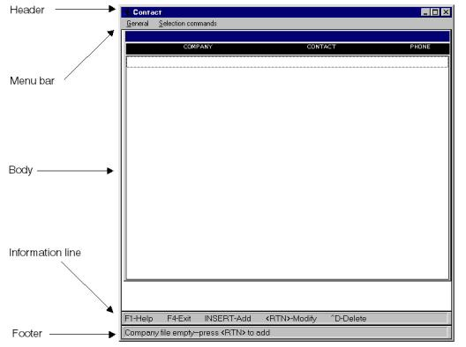
UI Toolkit Screen Regions

Slide 7
UI Toolkit Terms
Script Language
Script Files
Window Libraries

Slide 8
Script Language
Simple programming language Used to define User Interface “objects”:
Input windows
Menu columns
Lists
All script commands start with a “.”

Slide 9
Script Files
ASCII text file.
Source file containing Script language commands.

Slide 10
Script File Example: Input Window
.input Example1, 10, 70
.placement 8, 5
.border on
.title “Input Window Example”
.field field1 ,a10 –
,pos( 2, 2 ) –
,fpos( 2, 20 ) –
,prompt( “Field 1” )
.field field2 ,a10 –
,pos( 3, 2 ) –
,fpos( 3, 20 ) –
,prompt( “Field 2” )
.end

Slide 11
Script File Example: User Data Window
Used to hard code text in programs:
.window Example2, 1, 1
.border off
.user 10, 50
.data 1, “This is data element 1”
.data 2, “This is data element 2”
.data 3, “Etc.”
.data 4, “Remainder is blank for future expansion”
.end

Slide 12
Windows Library
A file containing “compiled” screen objects:
Synergy ISAM file with objects as records.
Source is one or more script files.
Created with the script compiler.
Used by the UI Toolkit applications at runtime.

Slide 13
Developing UI Components
Script File
Window
Library
Editor
Script
Compiler

Slide 14
Developing UI Toolkit Applications
Prog.dbr
Prog.dbl
Compiler
Linker
WND:tklib.elb
WND:tools.def

Slide 15
Running UI Toolkit Applications
Prog.dbr
WND:tklib.elb
Window
Library
Runtime

Slide 16
Getting Started with UI Toolkit
Define your windows and menu columns in a window script file.
Compile the script file using:
Synergy\BuildSynergyWindowsLibrary.bat
Write a Synergy program that calls UI Toolkit subroutines. You will need to add the following to the data division of your program:
.include "tims.def" library "cu_records"
Compile the source code.
Run your application.

